Slide 1
ERROR 092 CANISTER IDENTIFICATION CRITERIA

Slide 2
Objective
This document outlines the checks to identify canisters that cause Status_Code 5 (Error 092 - Dispense flow rate out of spec)

Slide 3
Criteria
Canister checks.
Canister age
Canister counts of Status_Code 5.
Success dispensing in other KPs.
KP Checks
Fuel level
Recent refill
KP’s most recent Status_Code 5
Trend of Status_Code 5 on the KP
Softwares to be used: Grafana

Slide 4
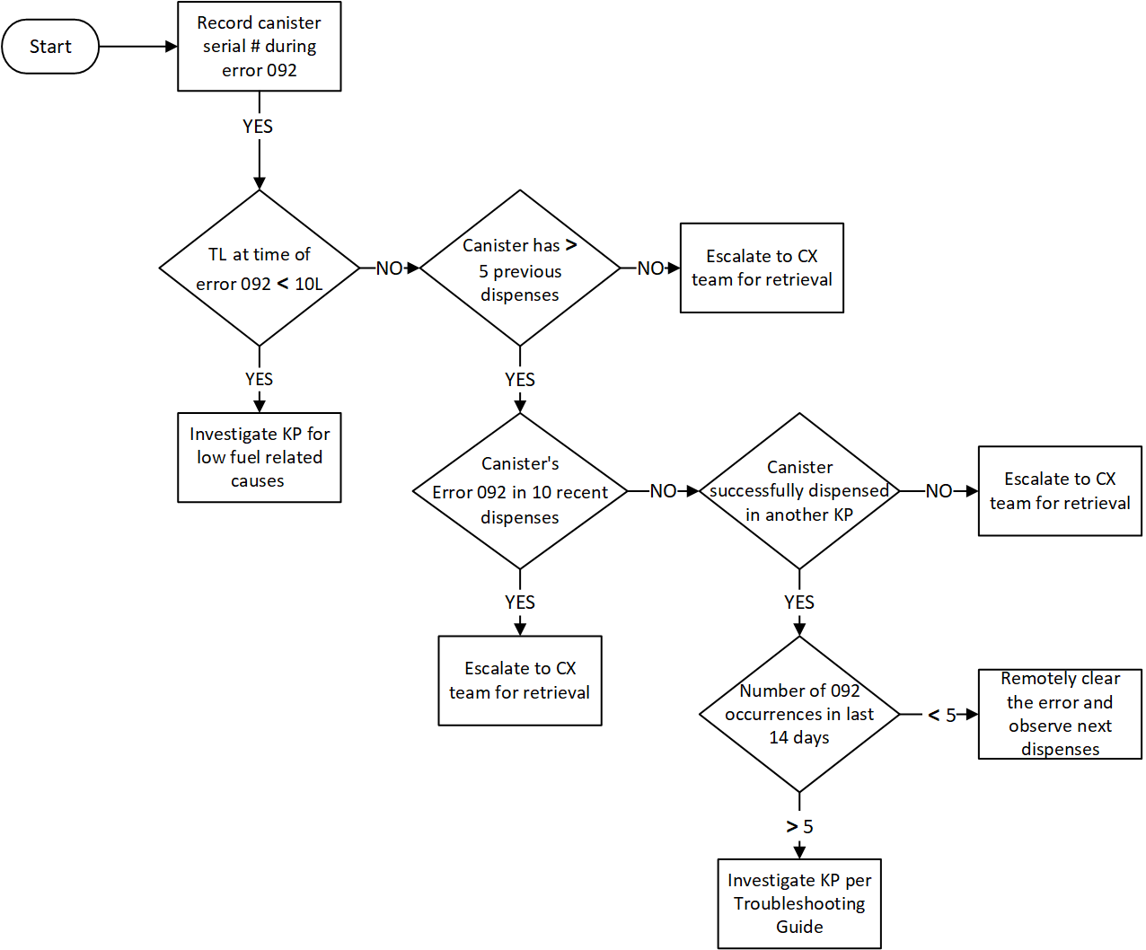
Flowchart
Examples
New canister
Old canister
Canister with SC5>5
KP with repeated SC5

Slide 5
Recommendations
Changes on Grafana
Provide a filtered view of canisters with more than 5 Status_Code 5 in the 10 dispenses.
Include TL<10L filter to exclude KP out of fuel causes when displaying canister listing/dispenses.
Tabulate Error 092 numbers per KP in the last 14 days in Grafana with the TL<10L filter for easy identification of KP in need of more attention. Similar to CF tabulation.

Slide 6
Proposed Grafana Table
Canister Age
New - less than five dispenses since purchase
Old - more than five dispenses since purchase
# of Error 092
If canister has triggered error 092 in its last 10 dispenses
# of Occurrences in Primary KP
Record the number of error 092 in the last 14 days on the KP that the issues was experienced by the customer
KP Serial # | Canister Serial # | Canister Age | # of Error 092 | Last KP Serial # | # of occurrences in Primary KP
KP-0123 | 300123456 | New | Yes | KP-0012 | 6
KP-0345 | 300987654 | Old | No | - | 2

Slide 7
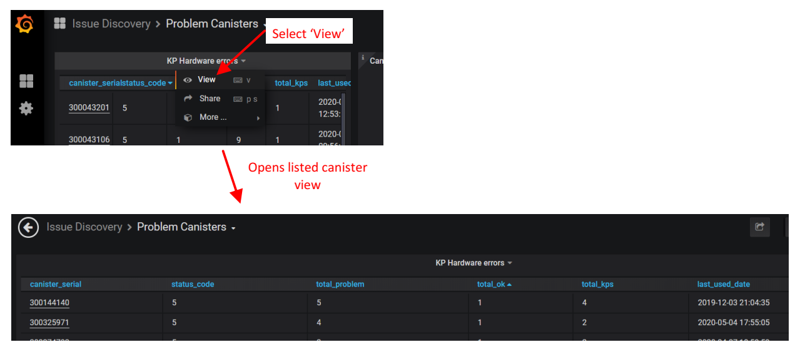
Procedure - Grafana
Listing canisters with Status_Code 5
Path: Issue Discovery>Problem Canisters>KP Hardware Errors

Slide 8
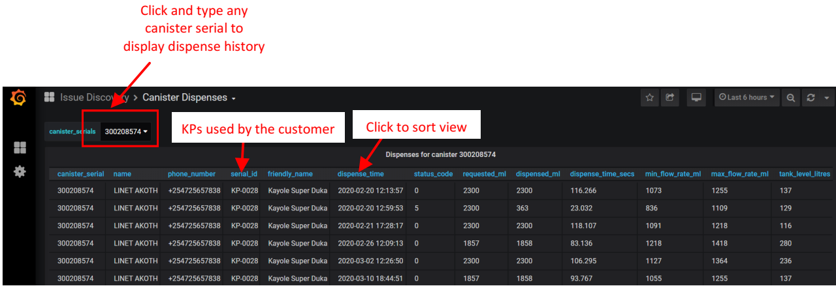
Procedure - Grafana
Searching for canister dispense history
Path: Issue Discovery>Canisters Dispenses

Slide 9
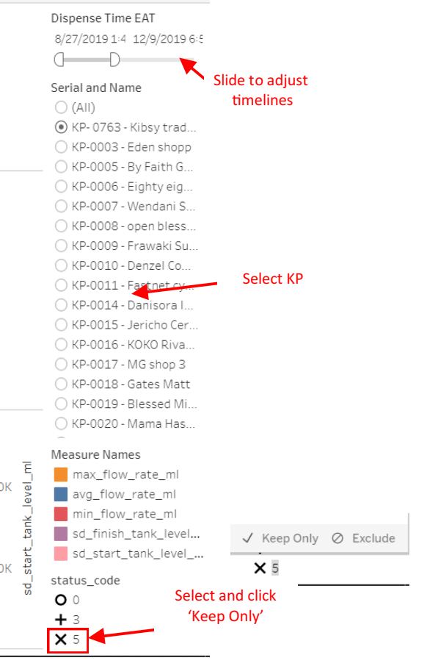
Procedure - Tableau
Exploring KP Dispense History
Path: Active>NOC & Production Engineering>KP Dispense Analysis>Dispenses

Slide 10
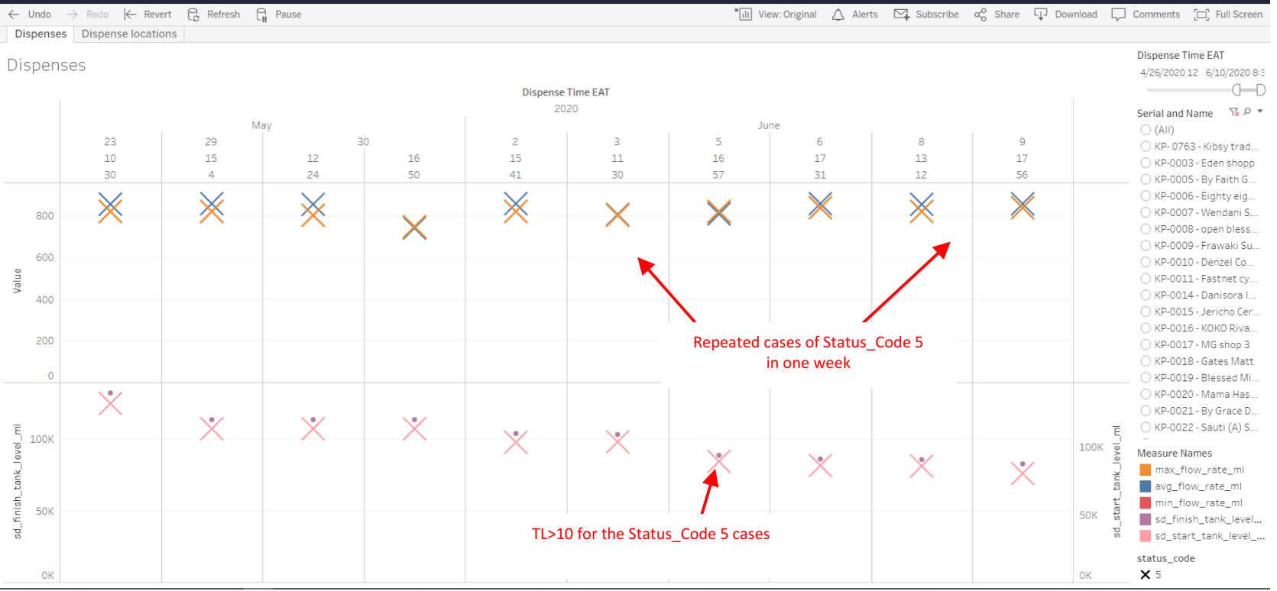
Procedure - Tableau
Exploring KP Status_Code 5 and Dispense History

